Slide 1


Retail Business Performance & Profitability Analysis
I can deliver it instantly in your preferred format.A comprehensive analysis of retail store data, identifying key drivers of revenue and profitability.
by Harsv Verma
Github Link: https://github.com/Harshver-16/Retail-Business-Performance-Profitability-Analysis

Slide 2

Understanding the Dataset
1650 Retail Records
Diverse Store Attributes
Across California stores
Size, age, category, efficiency
Performance Metrics
Revenue, marketing, footfall
Our analysis leveraged a rich dataset to uncover critical business drivers.

Slide 3
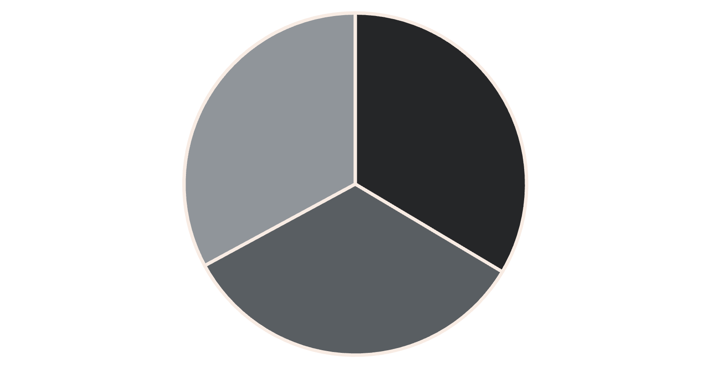
Revenue by Store Category
Key Insight
Grocery stores lead in revenue. This category presents a strong opportunity for targeted investment and expansion.
Grocery
Clothing
Electronics

Slide 4
Total Revenue by Location
₹125K+
₹90K+
₹65K+
Los Angeles
San Francisco
Sacramento
Leading the revenue charts
Strong market presence
Significant contribution
Top cities like Los Angeles are prime candidates for future expansion and resource allocation.

Slide 5

Top Performing Stores
"Palo Alto Clothing store recorded the highest revenue at ₹534.26/month."
This outlier highlights the potential for high-value sales even outside the dominant categories.

Slide 6
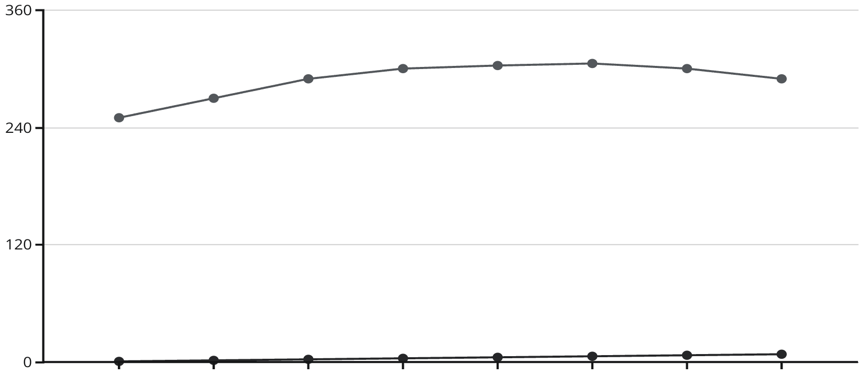
Promotions vs. Revenue
Optimal Promotions
Revenue peaks at 6 promotions (₹305.02).
Insight
Moderate promotions optimize revenue. Overdoing them can diminish ROI and customer engagement.
Number of Promotions
Average Revenue (₹)

Slide 7




Customer Footfall & Revenue
Higher Footfall
Increases store visibility
Boosts Sales
Positive correlation observed
Conversion is Key
Maximize traffic potential
While higher traffic generally boosts sales, effective conversion strategies are essential.

Slide 8




Revenue by Store Age
0-10 Years
Building foundation
11-20 Years
Solidifying presence
21-30 Years
Best performance (₹304.07)
30+ Years
Sustained reliability
Store maturity often correlates with higher brand trust and increased revenue.

Slide 9




Employee Efficiency Impact
Very High Efficiency
Direct Profit Boost
Average revenue: ₹300.39
Impact on the bottom line
Training Imperative
Invest in team development
Boosting team training and efficiency directly translates to improved profits and customer satisfaction.

Slide 10






Economic Indicator Influence
Increased Spending
Consumer confidence grows
Stronger Economy
Positive revenue trend
Location Strategy
Critical for market entry
Understanding macroeconomic conditions is crucial for effective retail location and expansion strategies.

